Slide 1
Rupture of the Fundão Dam, in Mariana/MG/BRAZIL
Maria da Glória Faria
Pery Saraiva Neto

Slide 2
On November 5th, 2015, in the city of Mariana/MG, the failure of the Fundão Dam, operated by Samarco Mining S.A. (controlled by Vale S.A. and by BHP Billiton Brasil Ltda) caused the biggest tragedy in Brazilian mining.

Slide 3
The flood of 34 million cubic meters of mud constituted by sand, silica, with high content of Fe (Iron) and Mn (Manganese), devastated the district of Bento Rodrigues and other urban areas, also causing severe impacts over 680 km in the beds and banks of the Gualaxo do Norte, Carmo and Doce Rivers.

Slide 4
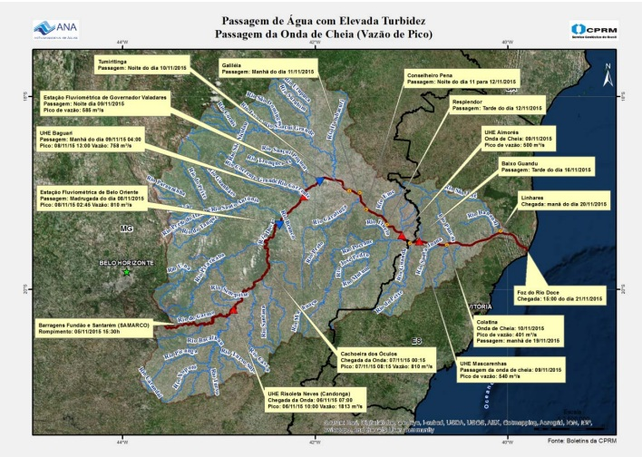
Cronology of the mud flow. Source: Technical Note #001/2016 – PRESID/IBAMA.

Slide 5
THE DISASTER IN NUMBERS

Slide 6
The flood caused by the spill of 34 million m³ of mud tailings from mining covered in only 40 minutes a distance of 10 km between the Fundão dam and the Bento Rodrigues dam, which was the most affected region.
The region had 18 confirmed deaths, 1 missing person and over 700 homeless and displaced people, besides the 207 buildings destroyed by mud, which represent 82% of the total number of 252 of the local existent buildings.

Slide 7
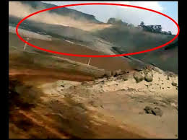

Slide 8
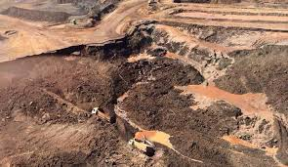

Slide 9
In its flow, over 6 communities and subdistricts of Camargos were affected by the mud:
Paracatu de Baixo,
Paracatu de Cima,
Campinas,
Borba,
Pedras e
Bicas,
In the State of Minas Gerais, 35 cities were affected by the mud and in the State of Espírito Santo, 4.

Slide 10
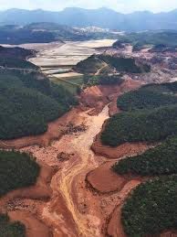

Slide 11
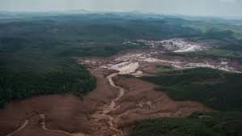

Slide 12
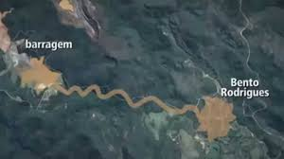

Slide 13
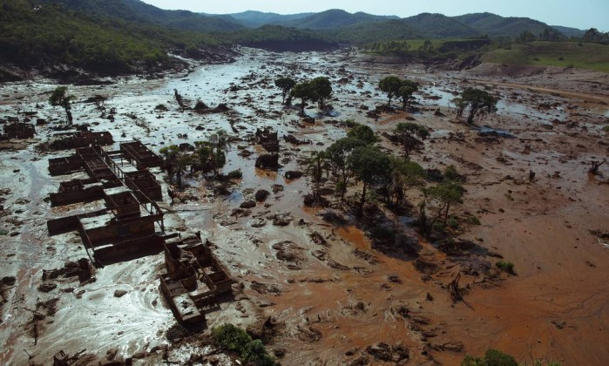

Slide 14
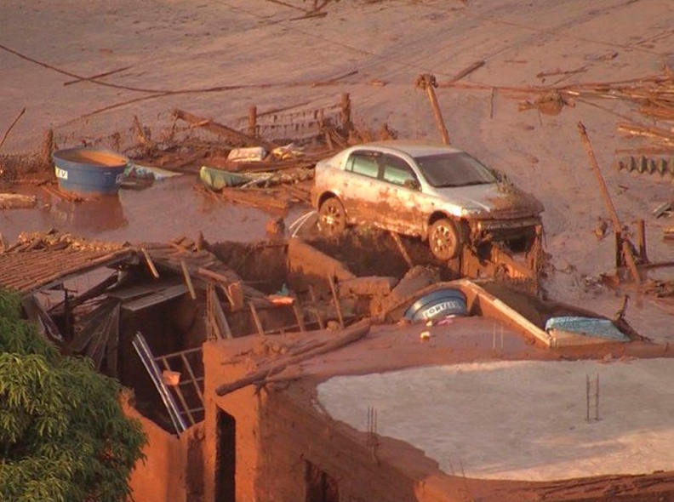

Slide 15
Direct and indirect damages to humans:
18 deaths;
1 missing;
256 injured;
380 sick;
644 homeless;
716 displaced;
319,565 affected;
TOTAL
321,626 VICTIMS

Slide 16
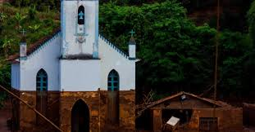

Slide 17
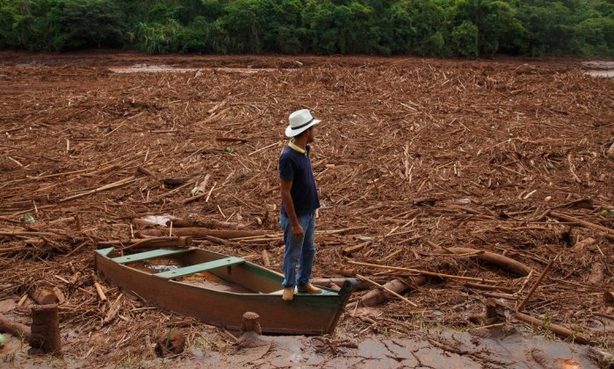

Slide 18
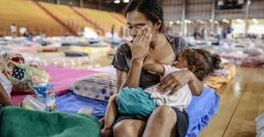

Slide 19
Immediate damages:
The disaster in Mariana affected 663.2 km of the body of water from the States of Minas Gerais and Espírito Santo, profoundly impacting the estuary of the Doce River as well as the coastal region above and below its mouth in the State of Espírito Santo. It also caused high turbidity, preventing the use of the water, maintaining the continuous sediment plume that hits the sorrounding of the river mouth, hindering the regeneration of the aquatic biota and of the impacted border, causing the siltation of the tanks of energy generation.

Slide 20
Effects on the Brazilian Coast
Contamination of 170 km of beaches, 110 km north of the Doce river mouth and 60 km south, affecting, also, the spawning of the sea turtles in the Biological Reserve of Comboios.

Slide 21
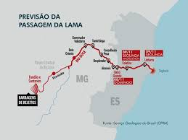

Slide 22
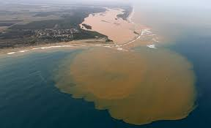

Slide 23
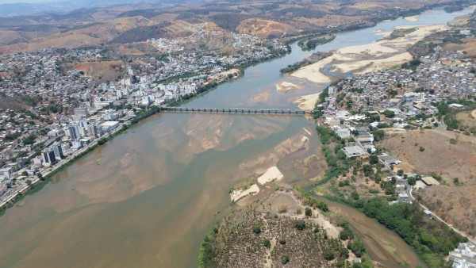
Doce river taken by the mud in Colatina, Espírito Santo.

Slide 24
Effects on vegetation
The ciliary forest, a marginal vegetation, was completely decimated along with the wildlife fauna therein.
There is an estimate that 1,026.65 ha were directly affected by the mud, being 10% constituted by Atlantic Forest, throughout 77 km of waterways.
Inside the affected region there are permanent preservation areas that suffered a devastation of approximately 374.81 ha of ciliary forest cover.

Slide 25
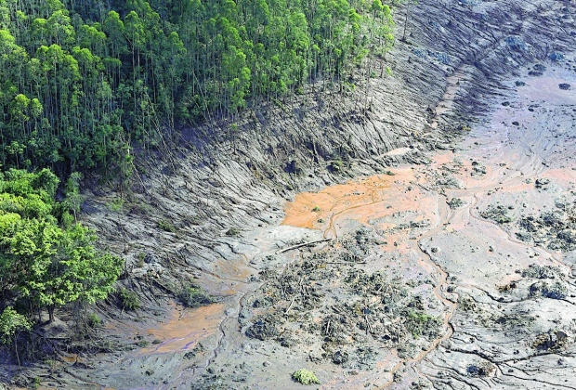

Slide 26
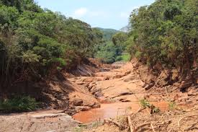

Slide 27
Effects on rivers and streams.
The high load of solid residue that blighted the river waters caused the mortanty of 3 tons of fishes in the Doce and in other rivers and of 500 kg in the sea, through the compromising of the gills, thus preventing the exchange of the oxygen.
The disaster affected 71 species of the aquatic biodiversity, amongst which the endangered and native species, as well as the wildlife fauna.

Slide 28
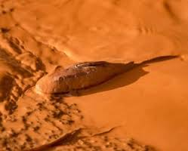

Slide 29
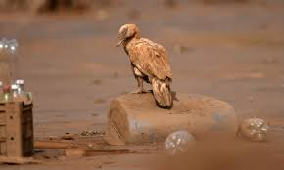

Slide 30
Other immediate damages:
One thousand animals, between cattle, horses as well as domestic and family consumption animals were lost. Other 485 animals were sheltered in a barn under the resposibility of Samarco, amongst which, dogs, cats, chickens, and others.

Slide 31
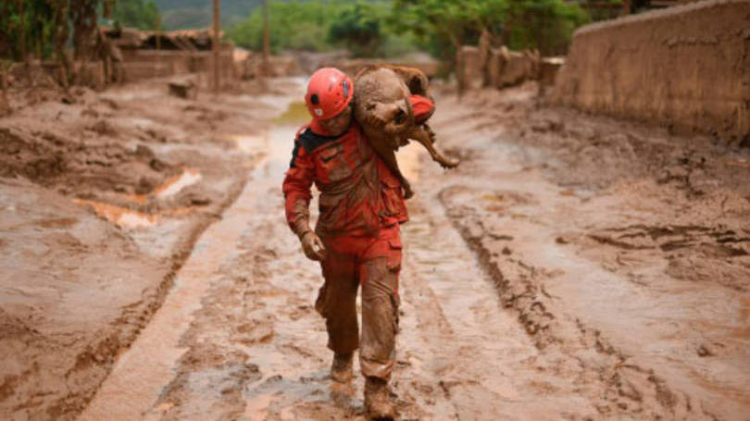

Slide 32
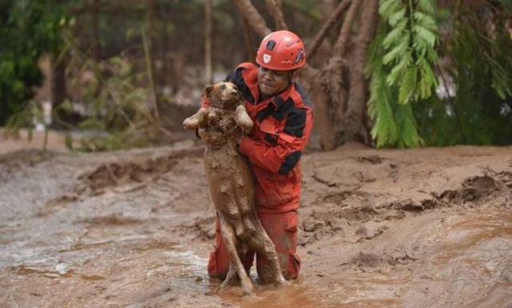

Slide 33
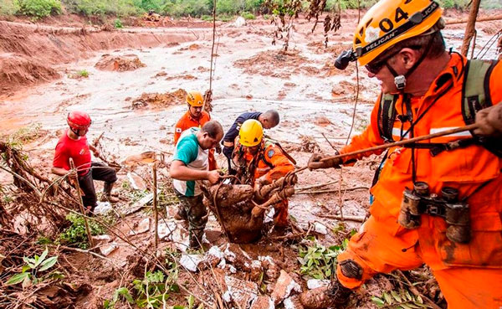

Slide 34
Other immediate damages
Discontinuance of the operation of the public water supply system in many cities and districts that capture the water of the Doce river, making it impossible for the stations to treat the captured water, due to its very high turbidity.

Slide 35
Other immediate and long term damages
Suspension of the fishing activity, affecting the subsistence of 1,249 fishers not only by the mortanty but also by the lack of conclusive studies regarding the contamination of the fishes, molluscs and crustaceans that inhabit the estuary and mouth of the Doce river.
Paralisation of both the production and of the distribution of milk in all the affected region, with as estimated loss of 21,000 liters per day (Mariana, Barra Longa, Rio Doce and Santa Cruz do Escalvado)

Slide 36
LEGAL PRINCIPLES
AND LEGAL PROVISIONS

Slide 37
Legal Assumptions
Federal Constitution of Brazil
The National Environmental Policy (Law # 6,938 of 1981) and the Law # 9,605 of 1998, which prescribes the criminal and administrative sanctions arising out of the conducts and activities deemed damaging for the environment.

Slide 38
Legal Assumptions
Strict Liability: the polluter is forced, regardless of the guilt, to indemnify or compensate the damages caused to the environment and to third parties.
Federal Constitution, Article #225, § 3rd: The conducts and activities considered damaging for the environment shall subject the offenders, either individual person or legal entity, to the criminal and administrative sanctions, disregard the obligation to compensate the damages caused. TRIPLE LIABILITY.
Concept of polluter: polluter, either individual person or legal entity, of public or private law, liable, directly or indirectly, for the environmental degradation activity.

Slide 39
Legal Assumptions
Environment: set of conditions, laws, influences and interactions of physical, chemical and biological orders, which allow, shelter and reign life in all its forms.
Degradation of environmental quality: adverse modification to the characteristics of the environment.

Slide 40
Legal Assumptions
Pollution: degradation of the environmental quality as a result of activities that, directly or indirectly:
a) damage the health, safety and well-being of the population;
b) create adverse conditions to the social and economic activities;
c) adversely affect the biota;
d) affect the aesthetics or sanitary conditions of the environment;
e) release matter or energy in disagreement to the established environmental standards.

Slide 41
Legal Assumptions
Atenuated system for establishment of causal link (CertaintyXProbability) – SCJ (“STJ”) – See the Superior Court of Justice Magazine, volumes 237, 238, 239/1 and 239/2.
Burden of proof, Inversion and Dynamic Distribution
“In the cases stipulated by law or in face of peculiarities of the cause in connection to the impossibility or to the excessive difficulty to fulfill the burden in the terms of the caput or to the higher convenience to obtain proof of the contrary, the judge may assign the burden diversely, through reasoned decision, and in such event shall grant the other party the opportunity to destitute itself from the assigned burden”.

Slide 42
COST PROJECTION FOR COMPENSATION OF DAMAGES

Slide 43
Conduct Adjustment Declaration
(CAD)
Was entered into on March 2nd, 2016 by the State Governments of Minas Gerais and Espírito Santo together with Samarco Mining and its controllers. The CAD comprehends socio-economic and socio-environmental agendas, as well as governance programs and financing for its implementation, based on all the impact obtained in prior studies.

Slide 44
Fines prescribed by the CAD:
R$100 Thousand Reais for non-compliance with the deadline for the presentation of each project, and a daily fine of R$ 10,000.00 (Ten Thousand Reais) for persistence of such failure.
R$1 Million Reais for each non-compliance, cumulated with the daily fine of R$50,000.00 (Fifty Thousand Reais) per item with which the non-compliance persists.

Slide 45
Fines prescribed by the CAD:
R$500 Thousand Reais for the non-compliance with the deadline for the constitution and start-up of the foundation, cumulated with the daily fine of R$50,000.00 (Fifty Thousand Reais) for as long as the non-compliance persists.
R$50 Thousand Reais per non-compliance of any other obligation, cumulated with the daily fine of R$10,000.00 (Ten Thousand Reais) also per non-compliance for as long as it persists.

Slide 46
The CAD prescribes a schedule related to the hydric safety and water quality:
R$50 Million Reais in the second semester of 2016;
R$100 Million Reais in the first semester of 2017;
R$100 Million Reais in the second semester of 2017;
R$125 Million Reais in the first semester of 2018;
R$125 Million Reais in the second semester of 2018.

Slide 47
The CAD also establishes the provision of a minimum value of R$1 Billion and One Hundred Million Reais for the restauration of the forest and the production of water.

Slide 48
Samarco shall perform annual contributions in the years of 2016 to 2018:
2016 the contribution shall correspond to R$2 Billion Reais;
2017 shall correspond to R$1,2 Billion Reais;
2018 shall correspond to R$1,2 Billion Reais

Slide 49
Samarco Foundation shall annually contribute, for the period of 15 years, the fixed amount of R$240 Million Reais to the execution of the projects and measures of compensatory nature comprehended by the agendas.

Slide 50
Compensation and mitigation sought through the Public Civil Action # 0069758-61.2015.4.01.3400, filed by the Federal Union, the Brazilian Institute of Environment and Renewable Natural Resources – “IBAMA”, the Chico Mendes Institute of Biodiversity Conservation – “ICMBio”, the National Water Agency – “ANA”, the National Department of Mineral Production – “DNPM”, the State of Minas Gerais, the State Forest Institute – “IEF”, the State Water Management Institute – “IGAM”, the State Environment Foundation – “FEAM”, the State of Espírito Santo, the State Institute of Environment and Hydric Resources – “IEMA” and the State Hydric Resources Agency – “AGERH” in face of Samarco, Vale and BHP Billiton Brasil, processed in the 12th Federal Court of the Judiciary Section of Minas Gerais.
Position 12/05/2016 – in the Attorney office

Slide 51
MARIA DA GLORIA FARIA
gloria@cnseg.org.br
PERY SARAIVA NETO
contato@perysaraivaneto.com.br

